Slide 1




Capstone Project - 4
Project Type - Classification
EDA on Email Campaign Effectiveness Prediction
By
Ashutosh Kumar
(Cohort Istanbul)

Slide 2
Points for Discussion
Business Task
Data Summary
Data Cleaning
Exploratory Data Analysis
Feature Engineering
Modelling
Conclusion

Slide 3
Business Task
A dataset containing 68353 records across 12 features has been given with information regarding the characteristics of Email marketing campaign.
The main objective is to understand the existing data so that a machine learning model can be built to predict the e-mail status to improve campaigns.
This is undertaken as an individual project.

Slide 4
Data Summary
Number of records (rows): 68353
Number of features (columns): 12
Out of 68353 rows, none of them are duplicate rows.
Out of 12 columns, 4 columns have missing values and 3 columns require conversion of data type.
These irregularities will be handled later during data cleaning step.

Slide 5
Data Summary (Contd.)
Email_ID: E-mail ID of recipients.
Email_Type: Differentiates between 2 different e-mail types: 1 and 2.
Subject_Hotness_Score: Measures the strength and effectiveness of mail subject.
Email_Source_Type: Differentiates between 2 different e-mail source types: 1 and 2.
Customer_Location: Differentiates between 7 different e-mail customer locations: A, B, C, D, E, F and G.
Email_Campaign_Type: Differentiates between 3 different e-mail campaign types: 1, 2 and 3.
Total_Past_Communications: Number of previous.
Time_Email_sent_Category: Differentiates between 3 different time of day category: 1, 2 and 3.
Word_Count: Number of words in the mail.
Total_Links: Number of links in the mail.
Total_Images: Number of images in the mail.
Email_Status: Differentiates between 3 different e-mail statuses: 1, 2 and 3, representing ignored, read & acknowledged, respectively. This is our target variable.

Slide 6
Data Cleaning
About 17% of data in ‘Customer_Location’ has missing values. Since a large number of observations have missing values in it and it was difficult to find a value to impute in relation to other features, it was skipped.
About 10% of data in ‘Total_Past_Communications’ has missing values; they were replaced with its mean.
About 3% of data in ‘Total_Links’ has missing values; they were replaced with its median.
About 3% rows in ‘Total_Images’ has missing values; they were replaced with its mode.
Datatype of ‘Total_Past_Communications’, ‘Total_Links’ and ‘Total_Images’ were converted to ‘int’ datatype for more convenience.

Slide 7
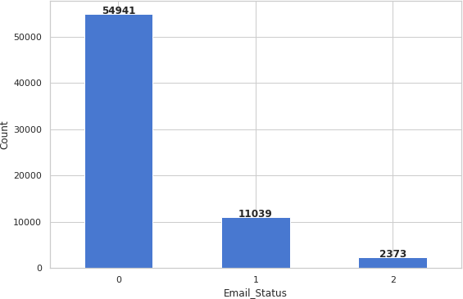
Exploratory Data Analysis
The dataset is highly imbalanced and “E’mail_Status’ 0 is the majority class and the rest of them are minority classes.

Slide 8
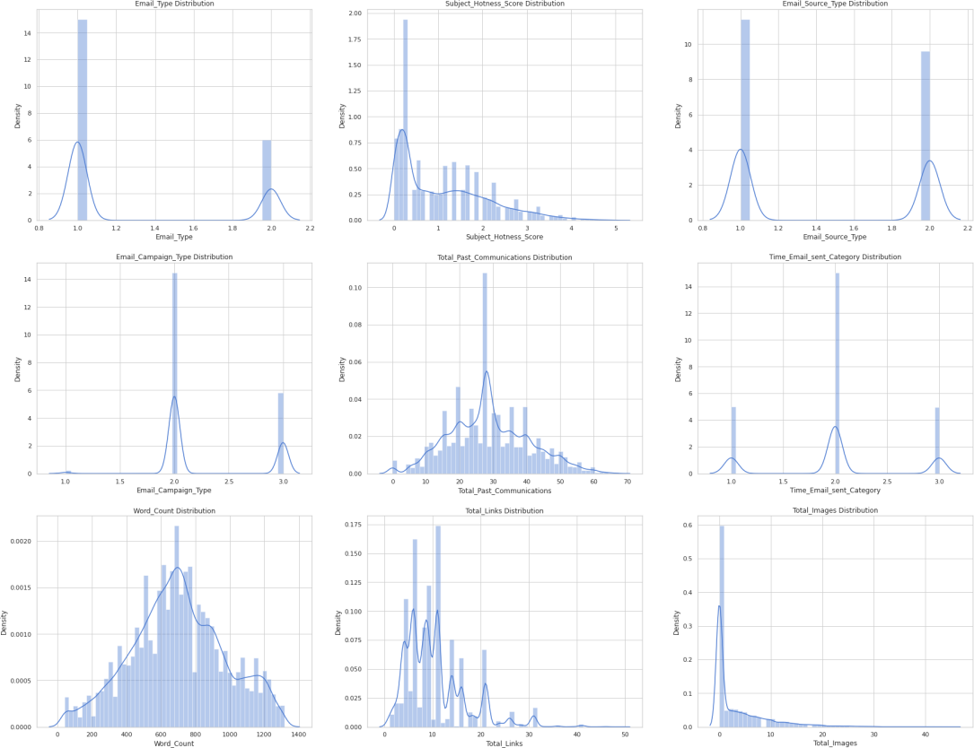
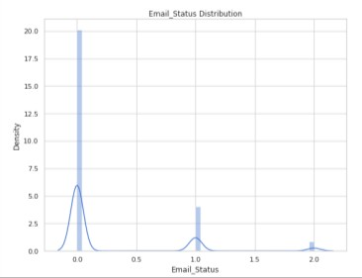
Exploratory Data Analysis (Contd.)
‘Subject_Hotness_Score’, ‘Total_Links’ and ‘Total_Images’ are positively skewed while ‘Total_Past_Communicati ons’ and ‘Word_Count’ are almost normally distributed.

Slide 9
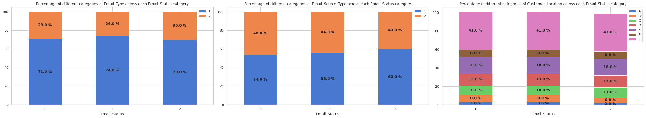
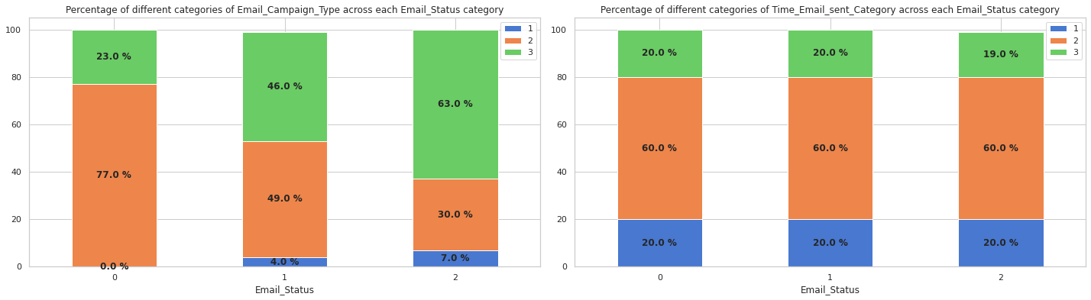
Exploratory Data Analysis (Contd.)
All categories of a feature have same distribution of e-mails across categories of ‘Email_Status'. ‘Email_Campaign_Type’ is the only feature which does not follow this trend. So it has the most impact on the target feature. If ‘Email_Campaign_Type’ is 1, then the mail has 66% chance of getting read and 23% chance of getting acknowledged.

Slide 10
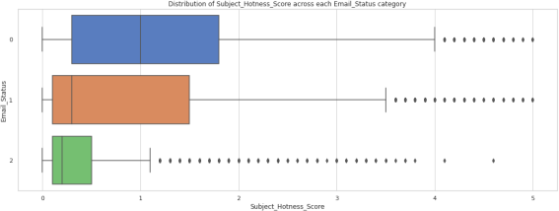
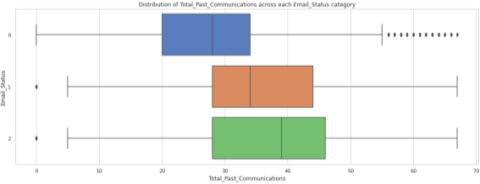
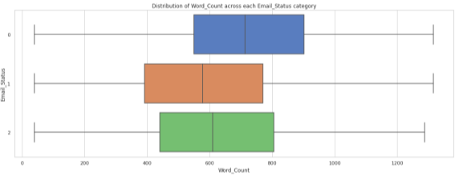
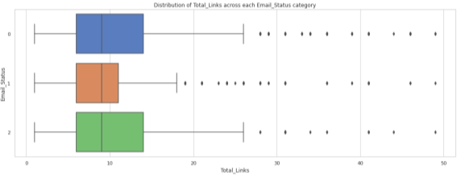
Exploratory Data Analysis (Contd.)
As the ‘Subject_Hotness_Score’ increases, probability of mails getting acknowledged decreases.
As the number of ‘Total_Past_Communications’ increases, probability of mails getting acknowledged or read also increases. As the ‘Word_Count’ increases, probability of mails getting ignored also increases.
The ‘Total_Links’ have similar distribution across each ‘Email_Status’ category but read mails have slightly less variance than others.
The ‘Total_Images’ have similar distribution across each ‘Email_Status’ category but acknowledged mails have slightly more variance than others.

Slide 11
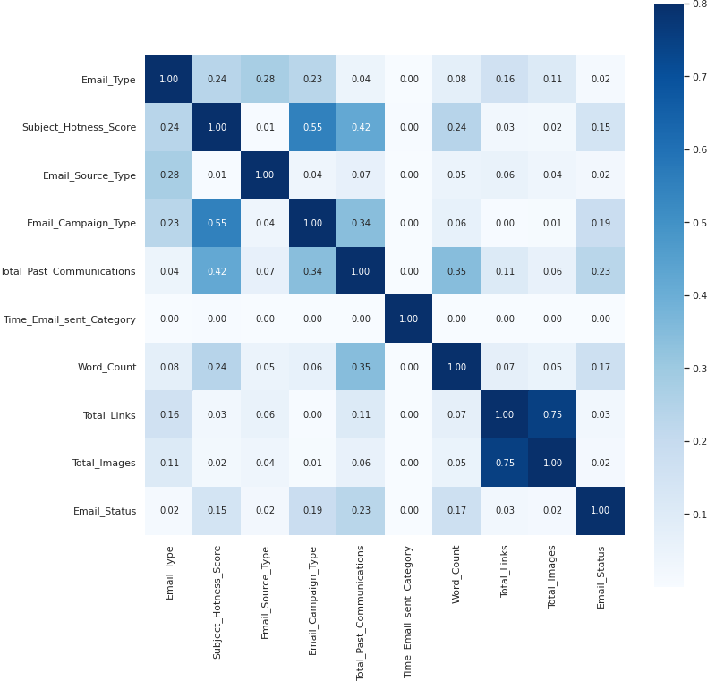
Exploratory Data Analysis (Contd.)
‘Time_Email_sent_Category’ has no correlation with Email_Status or any of the other independent features.
Multicollinearity can be observed between ‘Subject_Hotness_Score’,
‘Email_Campaign_Type’ & ‘Total_Past_Communications’ and ‘Total_Links’ & ‘Total_Images.’

Slide 12
Feature Engineering
‘Email_ID’ is dropped since it does not affect the status of e-mail.
‘Customer_Location’ is also dropped since it has a lot of missing values which cannot be easily imputed and also it does not have much impact on the target variable as all the locations have same probability of mails getting ignored, read and acknowledged.
‘Time_Email_sent_Category’ is also dropped as it is already established in EDA that it has no correlation to any features and therefore, it doesn't affect the mail status.

Slide 13
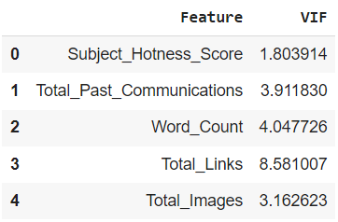
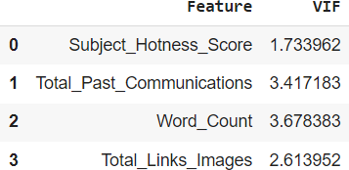
Feature Engineering (Contd.)
The variance inflation factor (VIF) of numerical features is calculated in order remove highly correlated features.
Features having VIF greater than 5 should be eliminated.
But it cannot be removed from our dataset to all because it is an important feature. So, it was combined with ‘Total_Images’ since they have a good correlation.
Then VIF of all remaining numerical features were calculated.
The only feature with VIF greater than 5 is ‘Total_Links’.
Now, all features have VIF less than 5.

Slide 14
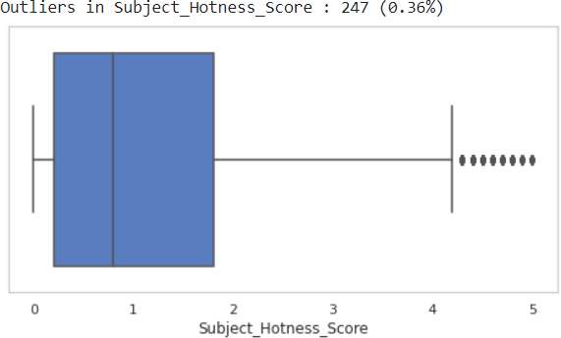
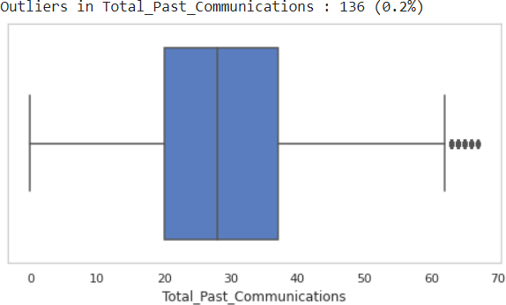
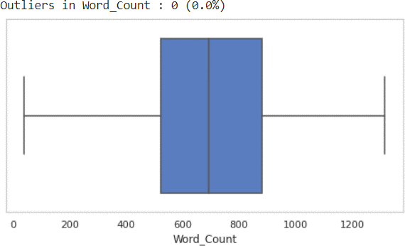
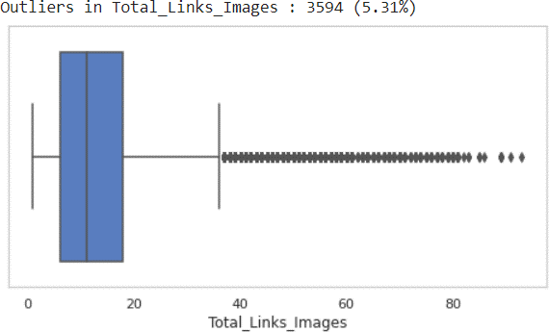
Feature Engineering (Contd.)
Outliers in ‘Subject_Hotness_Score’ Outliers in ‘Total_Past_Communications’
Outliers in ‘Word_Count’
Outliers in ‘Total_Links_Images’

Slide 15
Feature Engineering (Contd.)
Outliers in ‘Total_Links_Images’ (Majority Class)
Outliers in ‘Total_Links_Images’ (Minority Classes)
ľhe percentage of outliers in minoíity classes is above 5. So, it is better to not remove them.

Slide 16
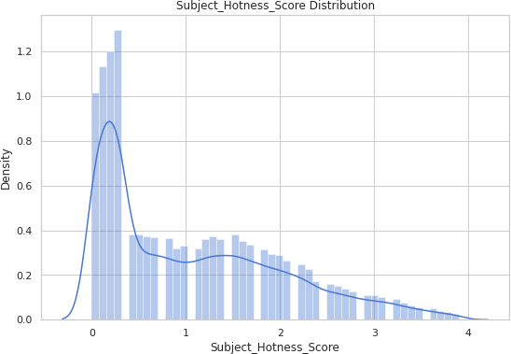
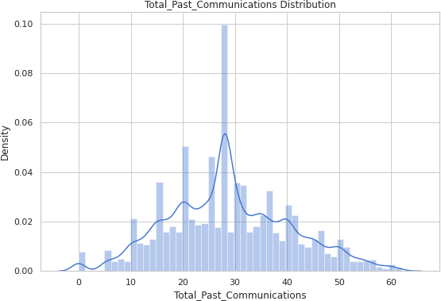
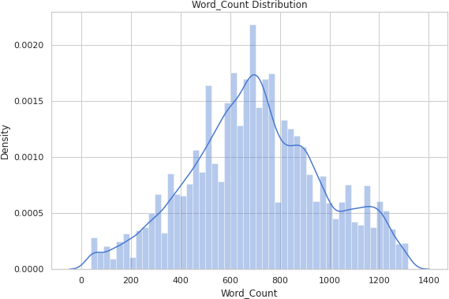
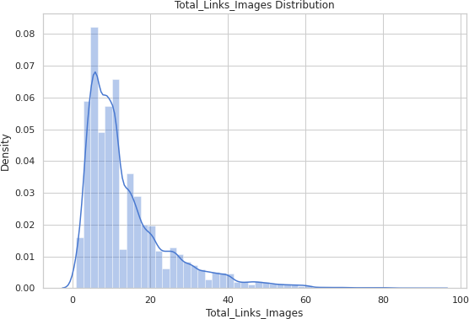
Feature Engineering (Contd.)
‘Subject_Hotness_Score’ and ‘Total_Links_Images’ are positively skewed. So, they must be transformed to normal distribution. ‘Subject_Hotness_Score’ has zero values while ‘Total_Links_Images’ has only positive values.

Slide 17
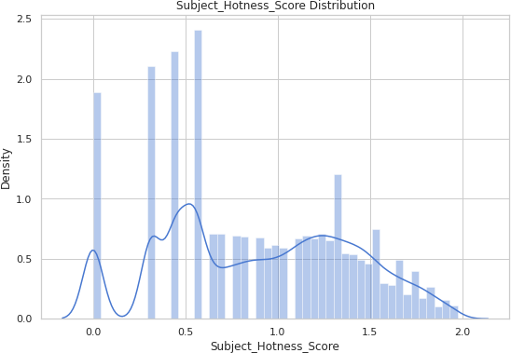
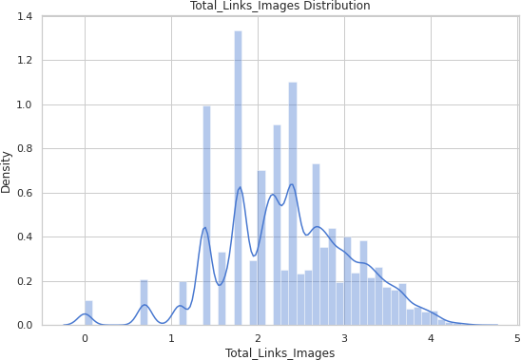
Feature Engineering (Contd.)
‘Subject_Hotness_Score’ is square root transformed and ‘Total_Links_Images’ is log transformed.

Slide 18
Feature Engineering (Contd.)
‘Email_Type’, ‘Email_Source_Type’ and ‘Email_Campaign_Type’ were encoded using one hot encoder.
To overcome dummy variable trap, one resultant feature from each encoded feature must be removed. There are only two unique values
in ‘Email_Type’ and ‘Email_Source_Type’, so removal of any one encoded feature from each of them would be sufficient. But in the case of ‘Email_Campaign_Type’, since there are more than two unique values, correlation matrix was used to decide which feature to remove.
‘Email_Campaign_Type_1’ was removed along with ‘Email_Type_2’ and ‘Email_Source_Type_2’.

Slide 19
Modelling
Input and target data were separated, and both were split into training and test
data with 25% test data.
Training and test data of independent features were scaled using standardization.
Two different techniques are used to balance the training data: Undersampling and SMOTE.
Model training was done with these data using 5 different algorithms:
Logistic classification
Decision tree classification
Random forest classification
XGBoost classification
KNN classification
Models were trained with each algorithm twice, first with under-sampled data and second with over-sampled data.

Slide 20
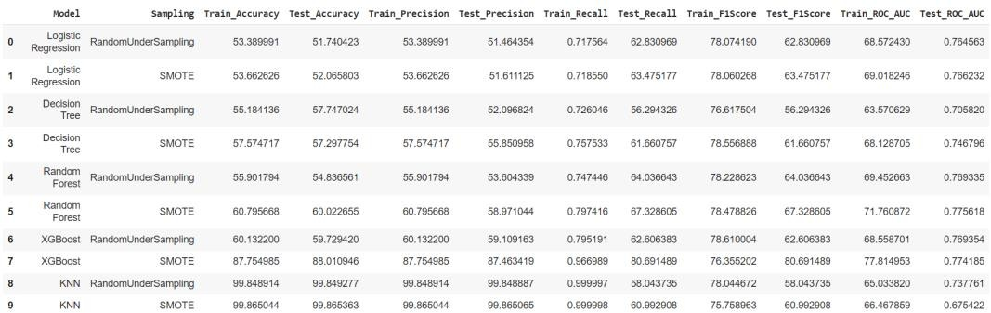
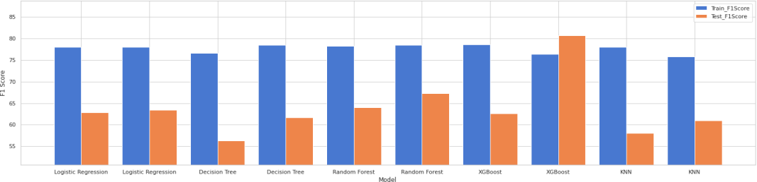
Modelling (Contd.)
Evaluation metrics like Accuracy, Precision, Recall, F1 Score and ROC-AUC were calculated for each model.
F1 score was used to compare different models and find out which one is better. Higher the F1 score, better the model.
The model built using XGBoost algorithm with SMOTE dataset has the highest F1 score, followed by the one using random forest with SMOTE dataset.

Slide 21
Conclusion
EDA Conclusions
Modelling Conclusions
No e-mails of campaign type 1 got ignored.
If campaign type is 1, then the mail has 66% chance of getting read and 23% chance of getting acknowledged.
Customer location or time of day does not affect the status of e-mail.
As the number of previous communication increases, the chances of the e-mail being read or acknowledged also increases.
E-mails tend to get ignored when word count is greater than 800.
Oversampled data seems to be better than undersampled data. This can be due to the fact that undersampling causes loss of information.
The model built using XGBoost algorithm with
SMOTE dataset performed better than the other models. It should be preferred for predicting mail statuses.
If model interpretability is more important than
accuracy, model built using logistic regression algorithm and SMOTE dataset should be chosen over the one using XGBoost algorithm. It is the best performer among the white box models.

Slide 22


